Slide 1
Programming the Power BI Service API
Notes:
This module examines the essential concepts and programming techniques involved when developing with the Power BI Service API. The modules explains how to authenticate with Azure AD and how to acquire and manage access tokens. The modules demonstrates security programming with the Azure Active Directory Authentication Library (ADAL) and compares it to security programming with the newly-released Microsoft Authentication Library (MSAL). Along the way, students will learn to program using the Power BI .NET SDK, to call the Power BI Amin API and to take advantage of the new preview support in the Power BI Service API for app-only authentication.

Slide 2
Agenda
Power BI Service API Overview
Understanding Authentication with Azure AD
Programming with the Power BI .NET SDK
Acquiring Access Tokens using MSAL
Calling to Power BI using App-only Tokens

Slide 3
What Is the Power BI Service API?
What is the Power BI Service API?
API built on OAuth2, OpenID Connect, REST and ODATA
API secured by Azure Active Directory (AAD)
API to program with workspaces, datasets, reports & dashboards
API also often called “Power BI REST API”
What can you do with the Power BI Service API?
Publish PBIX project files
Update connection details and datasource credentials
Create workspaces and clone content across workspaces
Embed Power BI reports and dashboards tiles in web pages
Create streaming datasets in order to build real-time dashboards

Slide 4
Authenticating with Azure AD
Custom applications must authenticate with Azure AD
Your code implements and authentication flow to obtain access token
Access token must be passed when calling Power BI Service API
Microsoft supports two endpoints for programming authentication
Azure AD V1 endpoint (released to GA over 8 years ago)
Azure AD V2 endpoint (released to GA in May 2019)
Azure Active Directory
Custom App
Access Token
Access Token
Power BI Service

Slide 5

Azure AD Endpoints and Libraries
Authenticating with the Azure AD V1 Endpoint
Heavily used over the last 5-6 years
Accessed through Azure AD Authentication Library (ADAL)
Authenticating with the Azure AD V2 Endpoint
Moved from preview to GA in May 2019
Accessed through Microsoft Authentication Library (MSAL)
Why move to the Azure AD V2 Endpoint?
Dynamic Incremental consent
New authentication flows (e.g. device code flow)

Slide 6
Power BI .NET SDK
Developing without the Power BI .NET SDK
Developing with the Power BI .NET SDK
Your C# Code
Power BI
Service API
Executing HTTP Requests
Capturing HTTP Responses
Serializing/Deserializing JSON
Your C# Code
Power BI
Service API
Power BI .NET SDK
Executing HTTP Requests
Capturing HTTP Responses
Serializing/Deserializing JSON

Slide 7
User APIs versus Admin APIs
Power BI User APIs (e.g. GetGroupsAsync)
provides users with access to personal workspace
provides users with access to app workspaces
provides service principal (SP) with access to app workspaces
Power BI Admin APIs (e.g. GetGroupsAsAdminAsync)
provides users with tenant-level access to all workspaces
does not currently support app-only authentication

Slide 8
Agenda
Power BI Service API Overview
Understanding Authentication with Azure AD
Programming with the Power BI .NET SDK
Acquiring Access Tokens using MSAL
Calling to Power BI using App-only Tokens

Slide 9
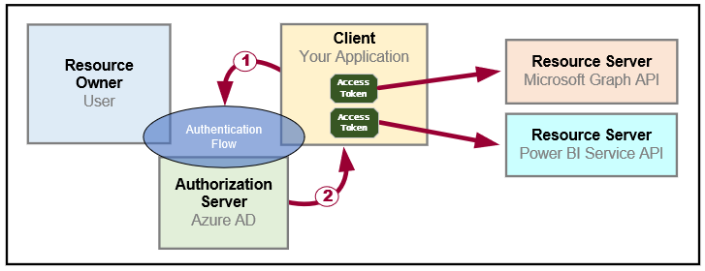
OAuth 2.0 Fundamentals
Client application calls to resource server on behalf of a user
Client implements authentication flow to acquire access token
Access token contains permission grants for client to call resource server
Client passes access token when calling to resource server
Resource server inspects access token to ensure client has permissions

Slide 10
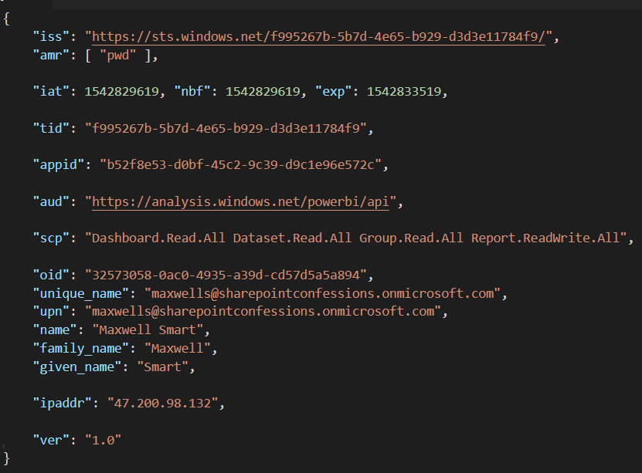
Access Token is a Bearer Token
It can be used by any who bears (e.g. steals) it
Always encrypt with HTTPS when transmitting access tokens

Slide 11
OAuth 2.0 Client Registration
Client must be registered with authorization server
Authorization server tracks each client with unique Client ID
Client should be registered with one or more Reply URLs
Reply URL should be fixed endpoint on Internet
Reply URL used to transmit security tokens to clients
Client registration tracks permissions and other attributes

Slide 12
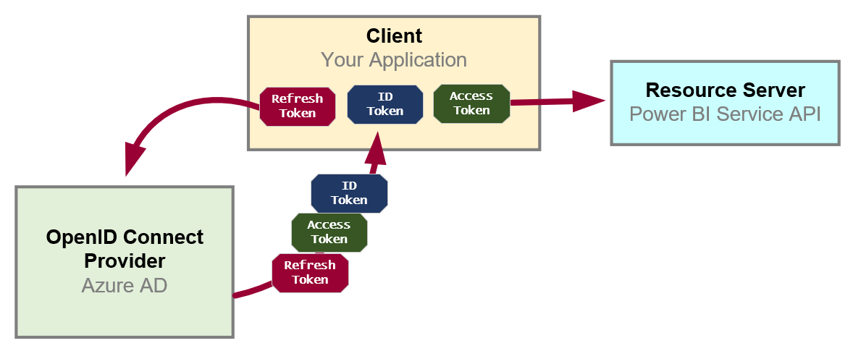
OpenID Connect Extends OAuth 2.0
OAuth 2.0 has shortcomings with authentication & identity
It does not provide client with means to validate access tokens
Lack of validation makes client vulnerable to token forgery attacks
Open ID Connect is standard which extends OAuth 2.0
OpenID Connect provider passes ID token in addition to OAuth 2.0 tokens
OpenID Connect provider provides client with keys for token validation

Slide 13
Authentication Flows
User Password Credential Flow (public client)
Used in Native clients to obtain access code
Requires passing user name and password across network
Device Code Flow (public client)
New style of authentication introduced with Azure AD v2 Endpoint
Client Credentials Flow (confidential client)
Authentication based on password or certificate held by application
Used to obtain app-only access tokens
Authorization Code Flow (confidential client)
Client first obtains authorization code sent back to browser
Client then obtains access token in server-to-server call
Implicit Flow (public client)
Used in SPAs built with JavaScript and AngularJS
Application obtains access token w/o acquiring authorization code

Slide 14
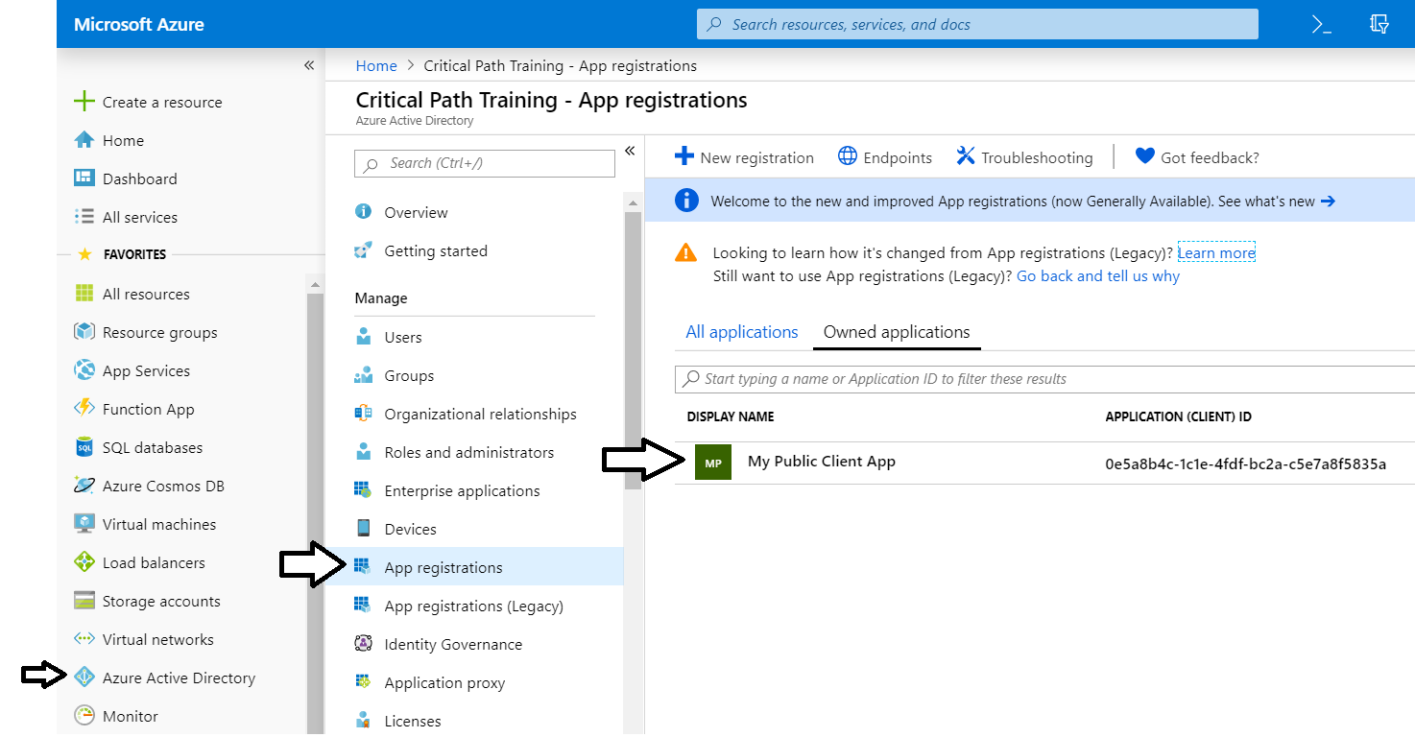
The Azure Portal
Azure portal allows you to register Azure AD applications
Azure Portal accessible at https://portal.azure.com
No Azure subscription required to register applications

Slide 15
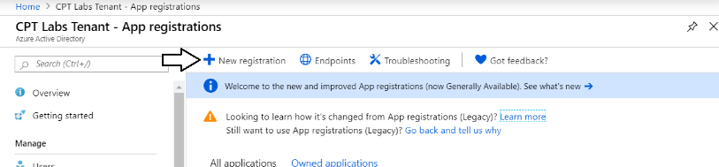
Azure AD Applications
Creating applications required for AAU authentication
Applications are as Native application or Web Applications
Application identified using GUID known as application ID
Application ID often referred to as client ID or app ID

Slide 16
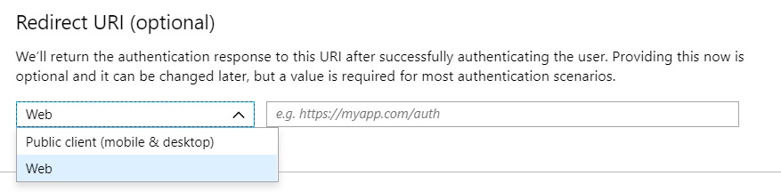
Application Types
Azure AD Application Types
Public client (mobile and desktop)
Web

Slide 17
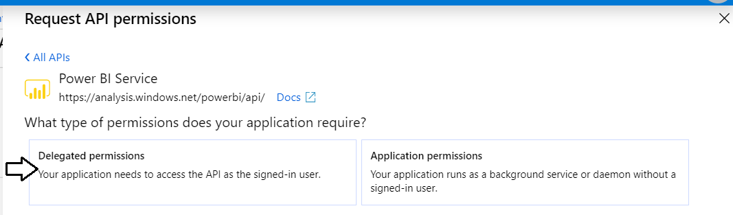
Delegated Permissions vs Application Permissions
Permissions categorized into two basic types
Delegated permissions are (app + user) permissions
Application permissions are app-only permissions (far more powerful)
Not all application types and APIs support application permissions
Power BI Service API does not support application permission

Slide 18
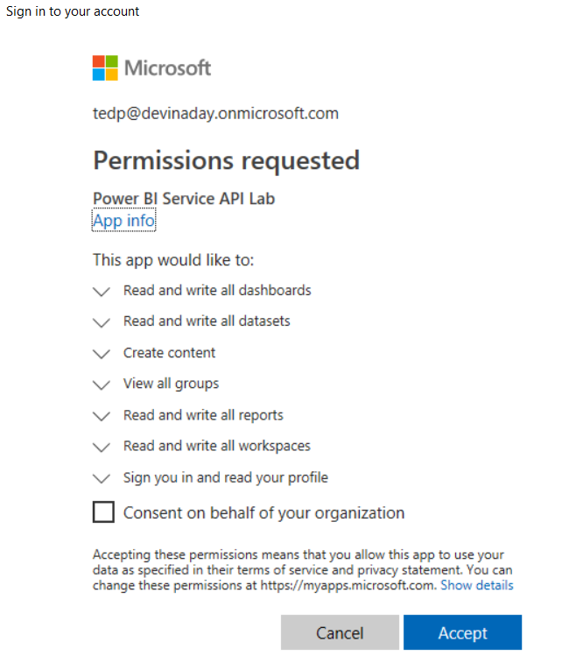
Interactive Consent for Delegated Permissions
Users must consent to delegated permissions
User prompted during first log in
User must click Accept
Only occurs once for each user

Slide 19
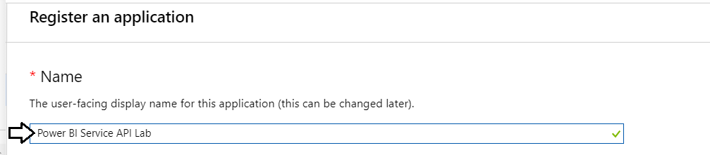
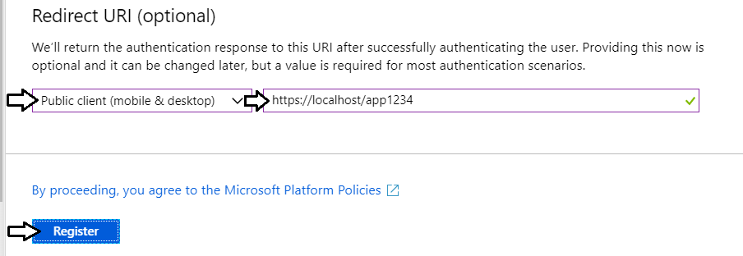
Creating a Public Client Application
Power BI supports Public Client Applications
Used for native applications and desktop applications
Requires Redirect URI for interactive logins

Slide 20
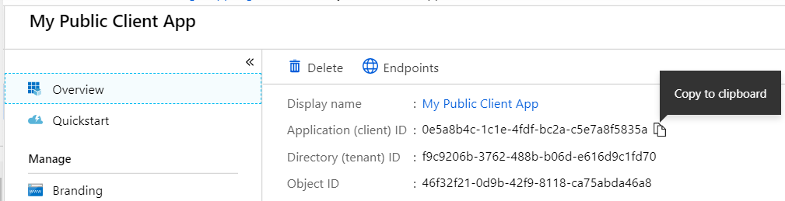
Copying the Application ID
Each new application created with Application ID
You cannot supply your own GUID for application ID
Azure AD will always create this GUID
You can copy the application ID from the Azure portal
Don’t forget this confusing fact…
Application ID == Client ID

Slide 21
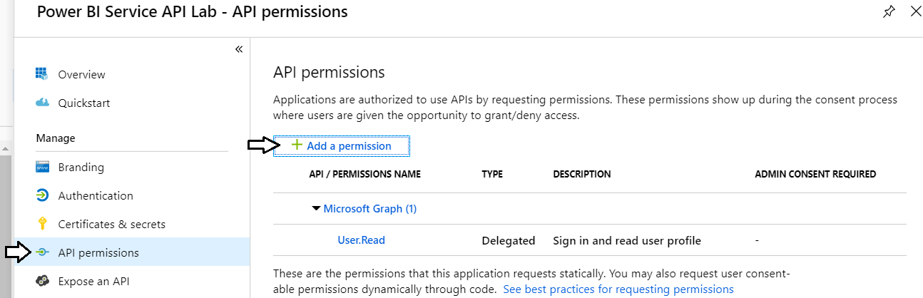
Configuring Required Permissions
Application configured with permissions
Default permissions allows user authentication – but that's it
To use APIs, you can assign permissions to the application

Slide 22
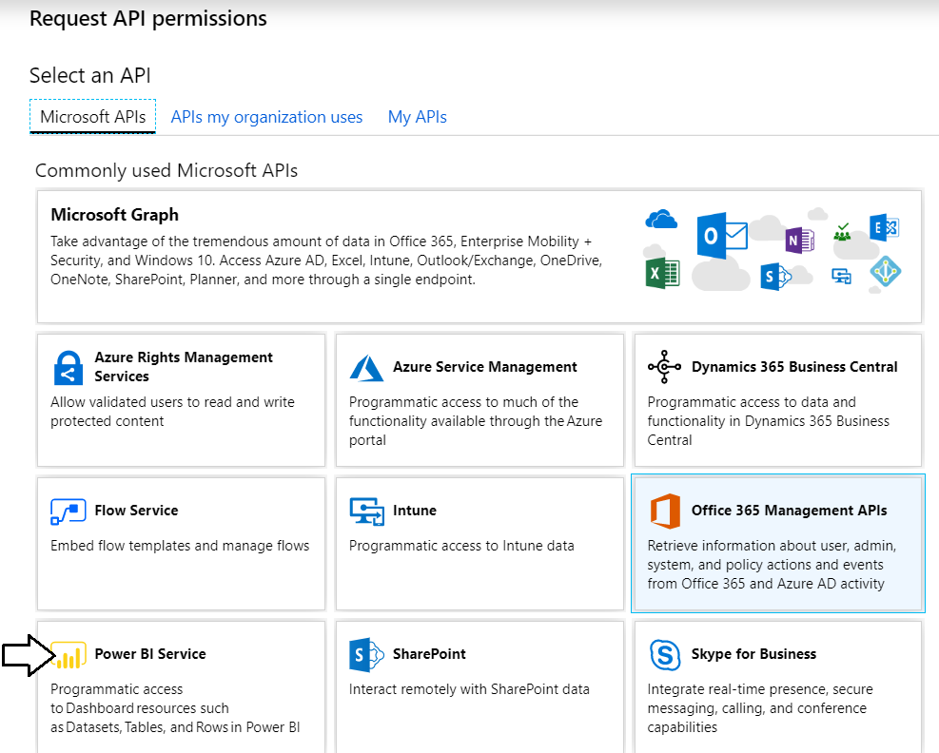
Choosing an API
There are lots of APIs to choose from
Microsoft Graph, Power BI Service, etc.

Slide 23
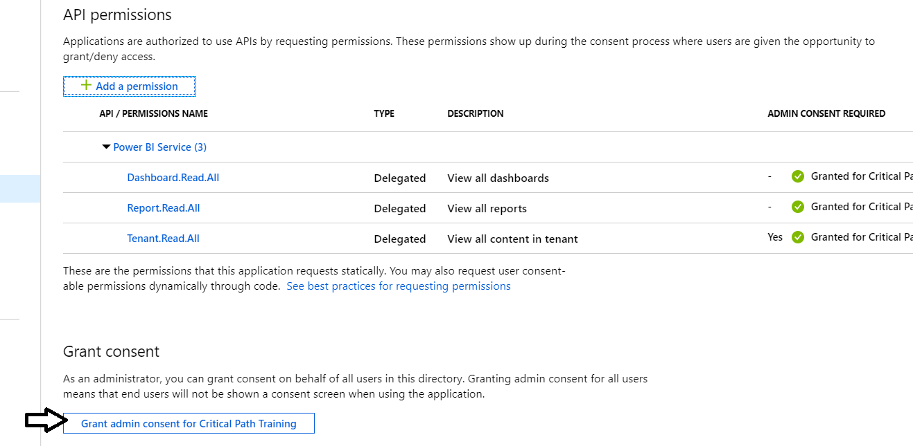
Granting Delegated Permissions
It can be helpful to Grant Permissions in Azure portal
Prevents the need for interactive granting of application by user
Might be required when authenticating in non-interactive fashion

Slide 24
AAD Service Principals
Azure AD creates service principal(s) for each application
Service principle created once per tenant
Service principle acts as first-class AAD security principal
Host Tenant
Tenant 2
Tenant 3
Application
Application ID
Service Principal
Object ID
Service Principal
Object ID
Service Principal
Object ID
Permission Grants
User1
User2
Permission Grants
User1
User2
Permission Grants
User1
User2

Slide 25
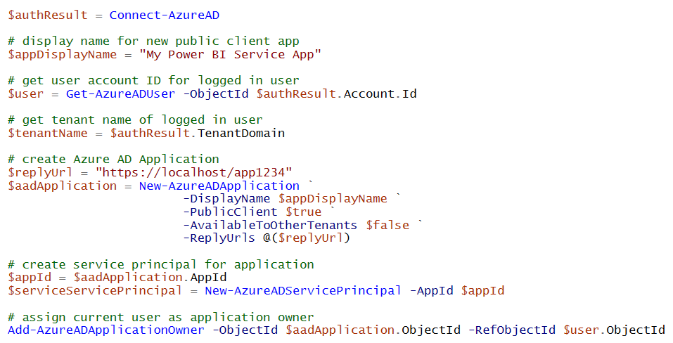
Registering AAD Apps with PowerShell

Slide 26
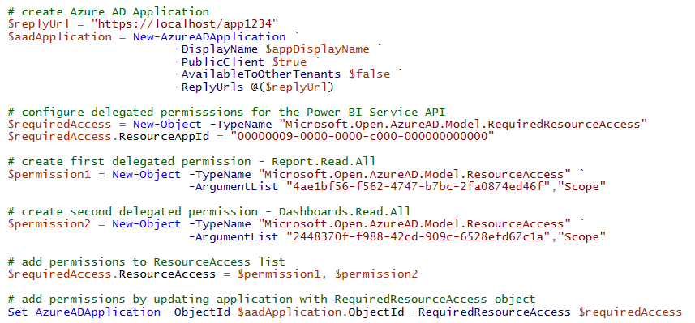
Configuring Delegated Permissions

Slide 27
Agenda
Power BI Service API Overview
Understanding Authentication with Azure AD
Programming with the Power BI .NET SDK
Acquiring Access Tokens using MSAL
Calling to Power BI using App-only Tokens

Slide 28
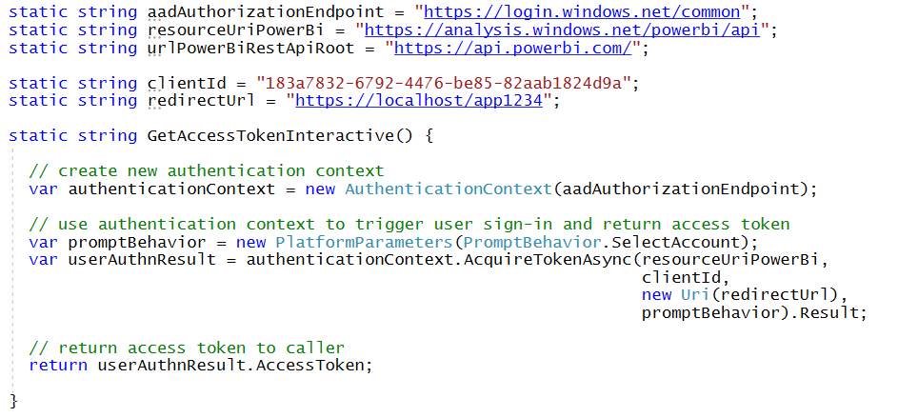
Interactive Access Token Acquisition Using ADAL with public client application

Slide 29
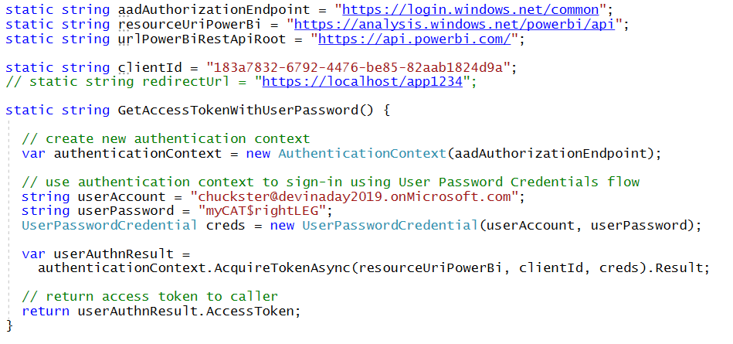
User Password Credential Flow Using ADAL with public client application

Slide 30
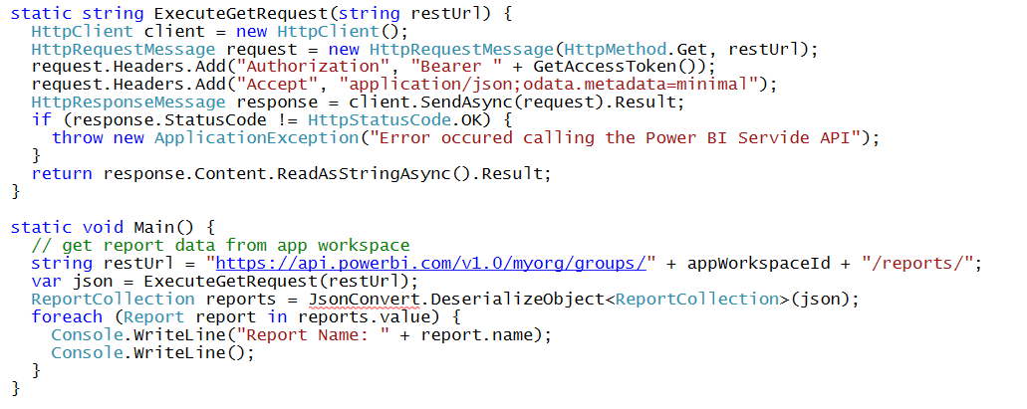
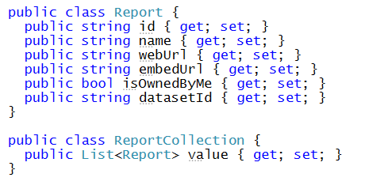
Calling the Power BI Service API Direct REST calls without using the Power BI .NET SDK
Your C# Code
Power BI
Service API
Executing HTTP Requests
Capturing HTTP Responses
Serializing/Deserializing JSON

Slide 31
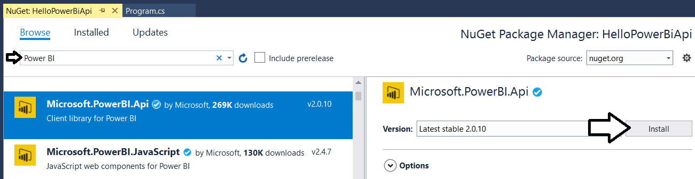
Power BI .NET SDK
Added as a NuGet package
Your C# Code
Power BI
Service API
Power BI .NET SDK
Executing HTTP Requests
Capturing HTTP Responses
Serializing/Deserializing JSON

Slide 32
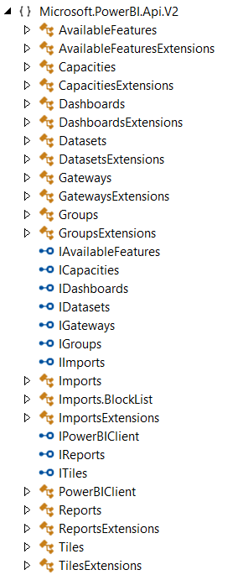
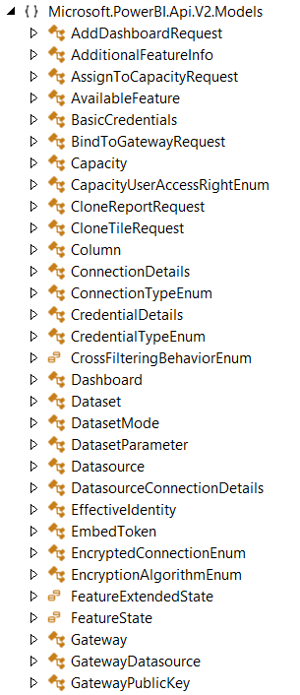
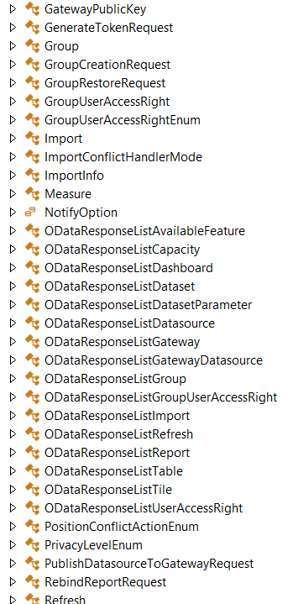
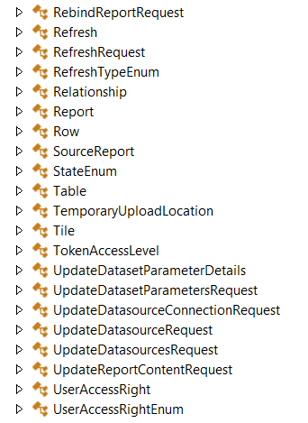
The Power BI .NET SDK Classes
SDK provides object model of classes

Slide 33
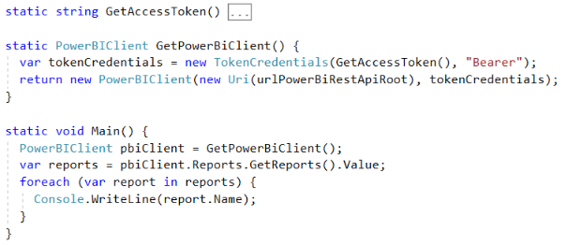
Initializing an Instance of PowerBIClient
PowerBIClient object serves as top-level object
Used to execute calls against Power BI Service
Initialized with function to retrieve AAD access token

Slide 34
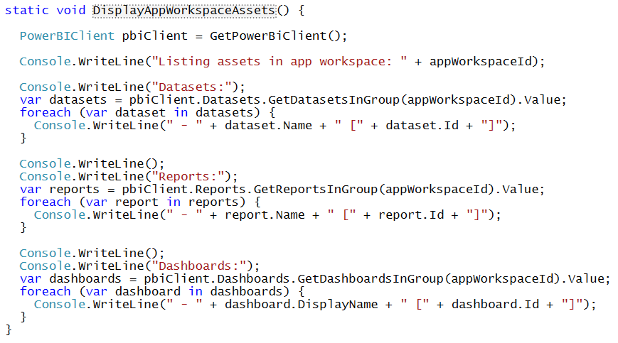
Enumerating Collections with PowerBiClient

Slide 35
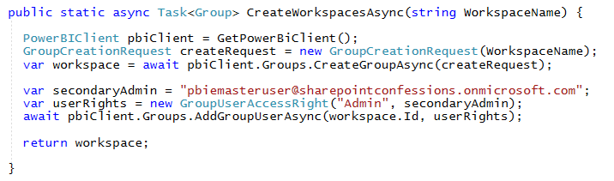
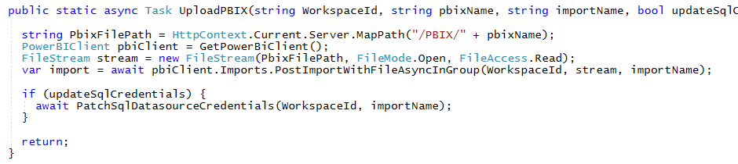
Creating Workspaces and Importing Content

Slide 36
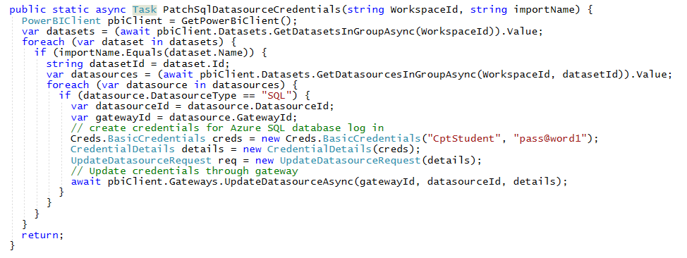
Patching Datasource Credentials

Slide 37
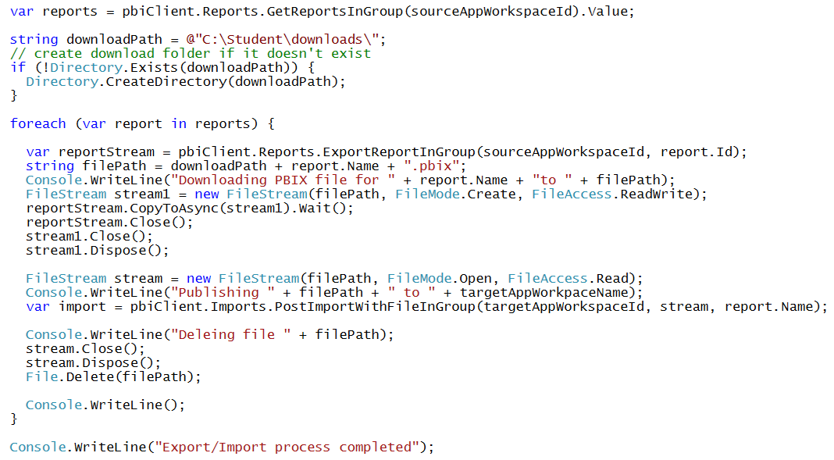
Exporting/Importing PBIX Files

Slide 38
Agenda
Power BI Service API Overview
Understanding Authentication with Azure AD
Programming with the Power BI .NET SDK
Acquiring Access Tokens using MSAL
Calling to Power BI using App-only Tokens

Slide 39
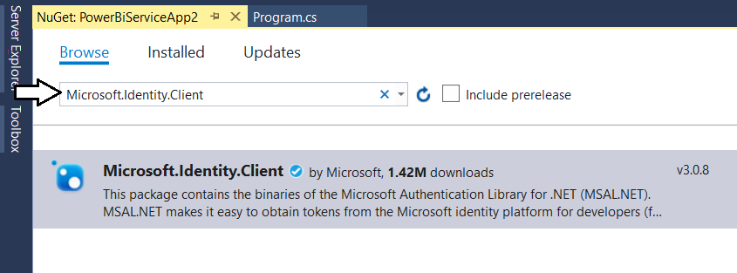
Microsoft Authentication Library (.NET)
Developing with the Microsoft Authentication Library
Provides access to Azure AD V2 Endpoint
Added to project as Microsoft.Identity.Client NuGet package
Provides different classes for public clients vs confidential clients

Slide 40
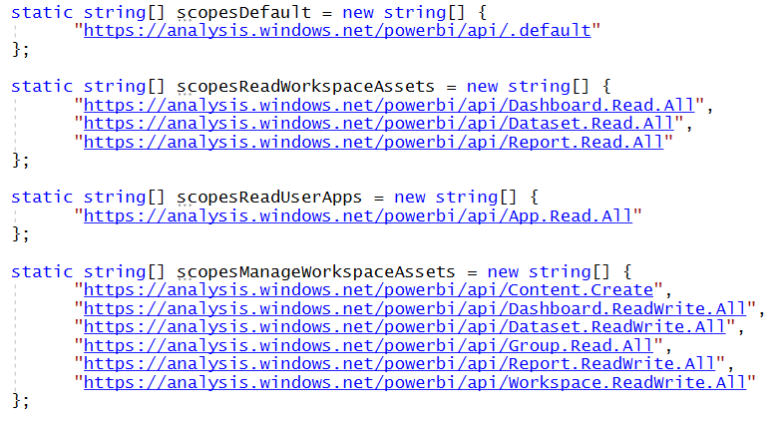
Power BI Service API Scopes
Azure AD V2 endpoint requires passing scopes
Scopes define permissions required in access token
Scopes defined as resource + permission https://analysis.windows.net/powerbi/api/ + Report.ReadWrite.All

Slide 41
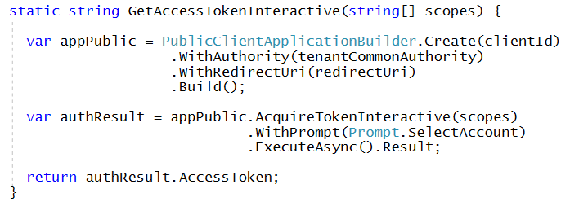
Interactive Access Token Acquisition Using MSAL with public client application
Flow implemented using PublicClientApplication object
Created using PublicClientApplicationBuilder object
Requires passing redirect URI
You can control prompting behavior

Slide 42
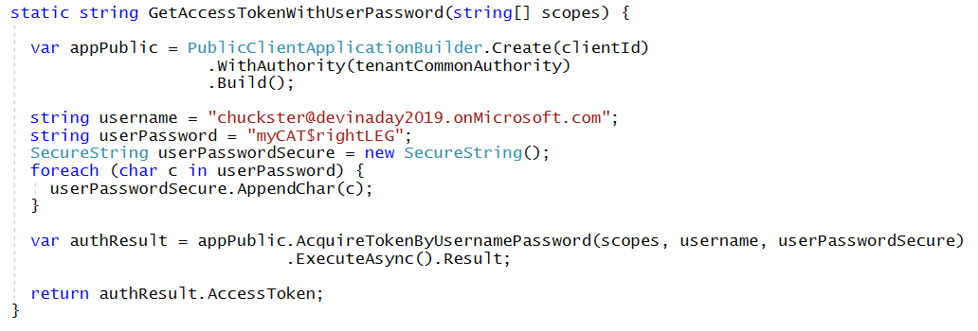
User Credential Password Flow Using MSAL with public client application
MSAL supports user credential password flow
Supported in .NET runtime but not in .NET CORE
Microsoft recommends against using this flow

Slide 43
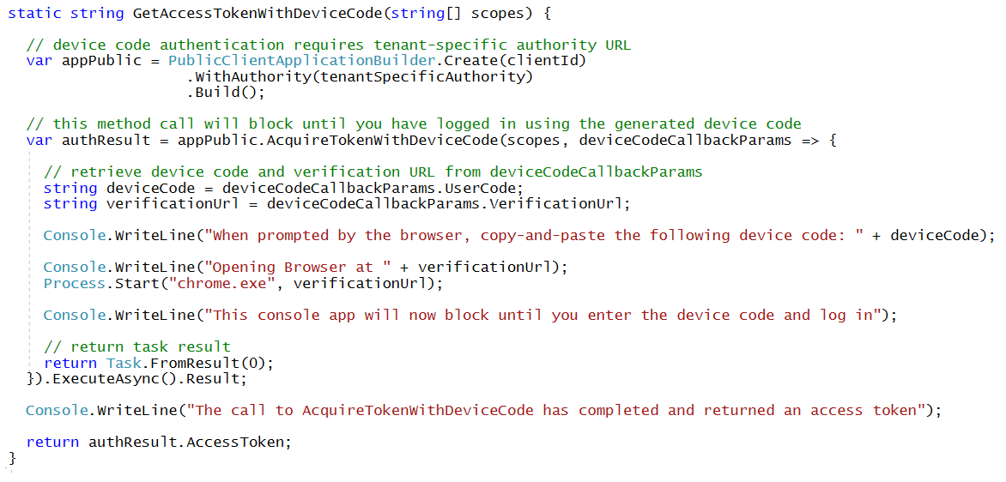
Device Code Flow Using MSAL with public client application
MSAL introduced this new flow with MSAL
Much more secure than user password credential flow
Not available in ADAL

Slide 44
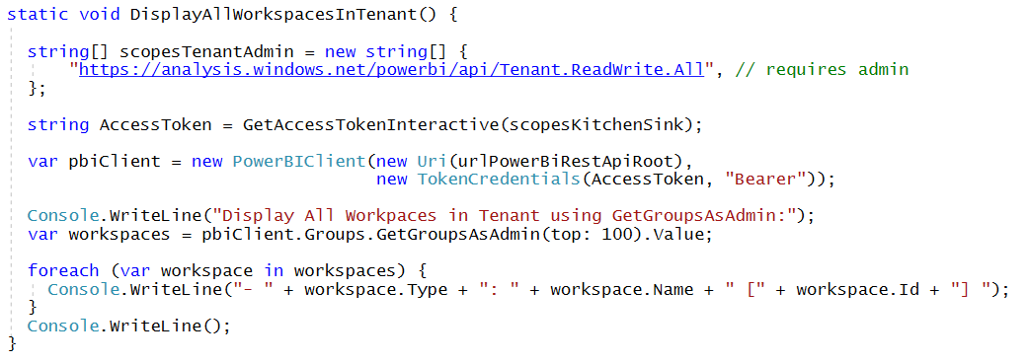
Calling into the Power BI Admin API
Admin API exposed using AsAdmin methods
Example:
Makes it possible to access every workspace in current tenant
Requires access token for user who is tenant or Power BI admin

Slide 45
Authenticating with MSAL

Slide 46
Agenda
Power BI Service API Overview
Understanding Authentication with Azure AD
Acquiring Access Tokens using ADAL
Programming with the Power BI .NET SDK
Acquiring Access Tokens using MSAL
Calling to Power BI using App-only Tokens

Slide 47
App-only Access Control
Service Principal used to configure access control
Requires the use of v2 app workspaces
Service principal added to app workspaces as admin
Access control NOT based on Azure AD permissions
App Workspace 1
Admins
User 1
User 2
App 1 Service Principal
Power BI Service
App 1 Service Principal
App-only Access Token
App Workspace 2
Admins
User 1
App 1 Service Principal
App 2 Service Principal

Slide 48
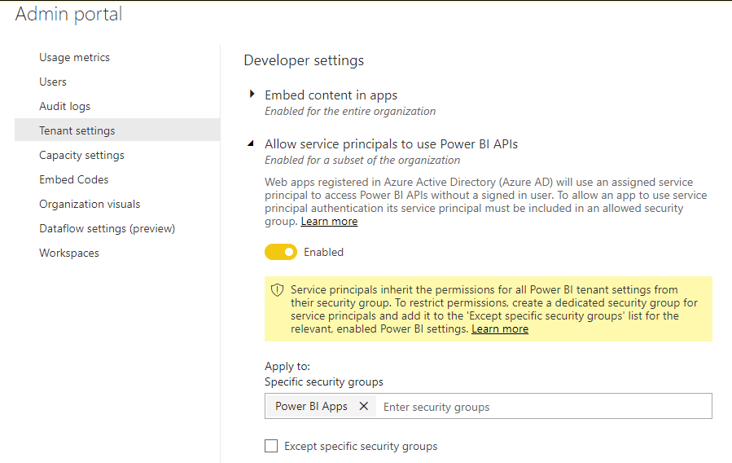
Tenant Setup
Your Power BI Tenant
These serviced principals now have access to the User APIs
Power BI Enabled
Service Principals
Service Principal
Application 1
Security Group
Power BI Apps
Service Principal
Application 2
Service Principal
Application 3

Slide 49
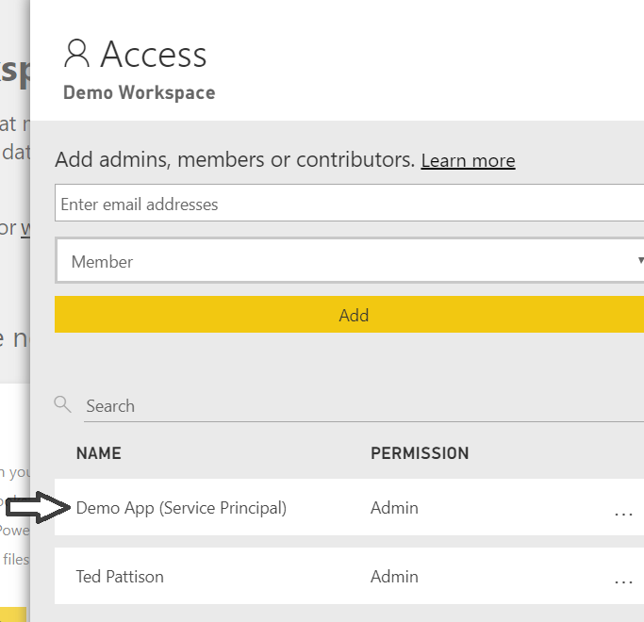
App-only Access with PBI Service API
Service Principal added to workspace as admin
Only works with v2 app workspaces
Provides full workspace access to service principal
App Workspace 1
Admins
User 1
User 2
App 1 Service Principal
App Workspace 2
Admins
User 1
App 1 Service Principal
App 2 Service Principal

Slide 50
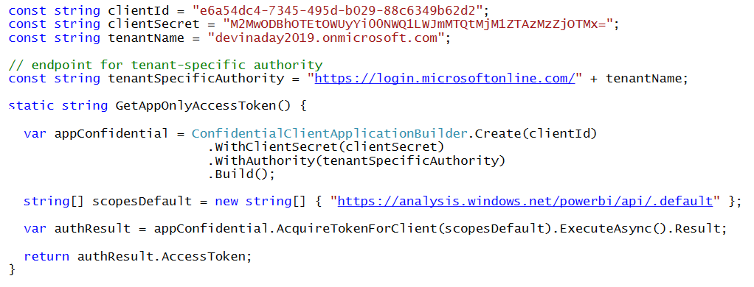
Client Credentials Flow Using MSAL with confidential client application
Client credentials flow used to obtain app-only token
Requires passing app secret (e.g. app password or certificate)
Requires passing tenant-specific endpoint

Slide 51
Summary
Power BI Service API Overview
Understanding Authentication with Azure AD
Acquiring Access Tokens using ADAL
Programming with the Power BI .NET SDK
Acquiring Access Tokens using MSAL
Calling to Power BI using App-only Tokens

